Slide 1

SPREADSHEET PROJECT: IT SUPPORT TICKET ANALYSIS
HARMANPREET KAUR

Slide 2

Introduction
In today’s digital-driven organizations, IT support teams play a critical role in ensuring smooth business operations.
This project focuses on analyzing IT support ticket data to understand performance, efficiency and improvement areas using Excel dashboards.

Slide 3
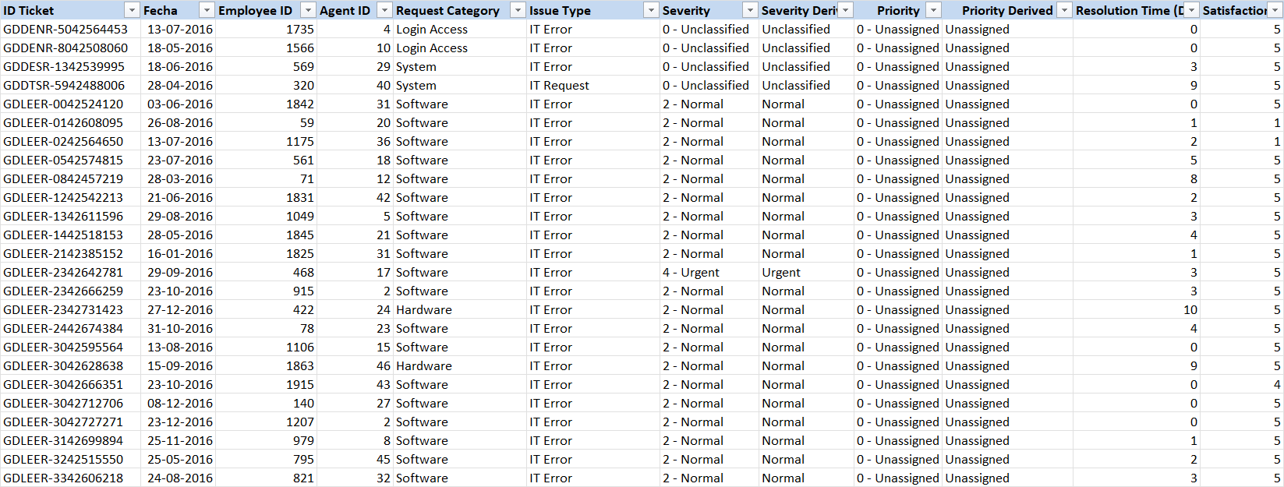
Problem Statement
You are tasked with analyzing the IT support ticket management system to understand the performance of IT agents, the efficiency of ticket resolution, and the satisfaction levels of employees. The objective is to identify high and low performers among IT agents, assess the overall effectiveness of the team, and pinpoint areas for improvement in the ticket resolution process. The ultimate goal is to make informed staffing decisions, including hiring, firing, and training, to enhance overall service quality and team performance.
SHEET 1 : TICKETS

Slide 4
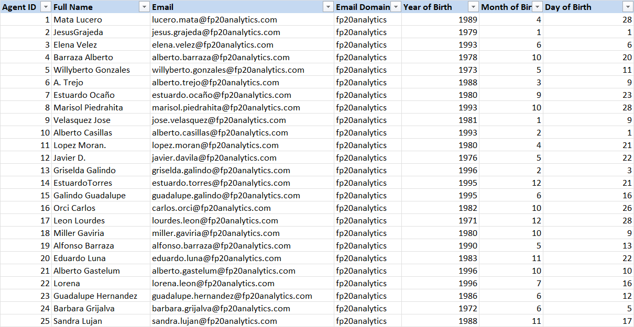
SHEET 2 : IT AGENTS

Slide 5
Data Attributes
SHEET 2 : IT AGENTS - Information about IT agents.
1. Agent ID : Unique identifier for the agent.
2. Full Name : Full name of the agent.
3. Email : Email address of the agent.
4. Year of Birth : Year the agent was born.
5. Month of Birth : Month the agent was born.
6. Day of Birth : Day the agent was born.
SHEET 1 : TICKETS - Information about IT support tickets.
1. ID Ticket: Unique identifier for the ticket.
2. Fecha : Date of the ticket.
3. Employee ID : ID of the employee who raised the ticket.
4. Agent ID : ID of the agent assigned to the ticket.
5. Request Category : Category of the request (Login Access, System, Software, Hardware).
6. Issue Type : Type of issue ( IT Error, IT Request).
7. Severity : Severity of the issue (Normal, Minor, Major, Urgent, Unclassified)
8. Priority : Priority level of the issue. (Low, Mid, High, Unassigned)
9. Resolution Time (In Days) : Time taken to resolve the ticket.
10. Satisfaction Rate : Satisfaction rate provided by the employee. (1-5 scale)

Slide 6


OBJECTIVES
Analyze ticket volumes & resolution times
Evaluate agent performance
Identify improvement and investment areas

Slide 7

DATASET SUMMARY
The dataset consists of IT support ticket records collected over multiple years. (2016-2020)
It includes two datasets:
-Ticket Data (ticket details, severity, priority, resolution time, satisfaction score)
-IT Agent Data (agent ID, name and demographic details)
In total, the dataset contains 16 original attributes and covers approximately 97,000+ ticket records handled by 50 IT agents.

Slide 8
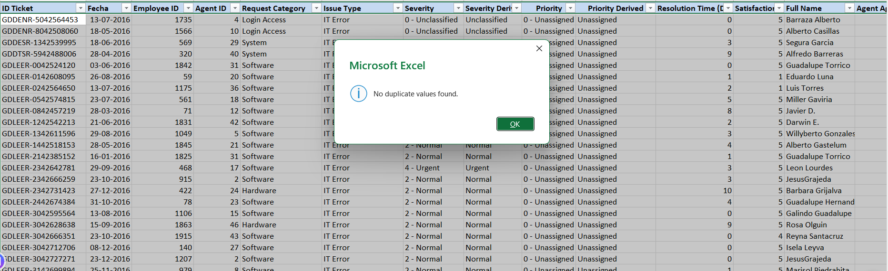
DATA CLEANING & PRE-PROCESSING
STEP 1 : Handling Missing Values
-Verified missing values using filters across all columns; no blank records were found.
STEP 2 : Removing Duplicates
- Verified duplicate entries by using REMOVE DUPLICATES under the data tab and no duplicate values were found.

Slide 9
DATA CLEANING & PRE-PROCESSING
STEP 3 : Standardizing Text and Formats
- Used TRIM function to remove extra white space in the columns.
- Extracted text and numeric values of SEVERITY column in different columns for better insights.
STEP 4 : Data Enrichment
Created additional columns other than from raw data to provide more detailed information.
For Example :
- Created different ‘Year’ and ‘Quarter’ column to provide yearly and quarterly trend of IT tickets.
- Created ‘Age Group’ and ‘Seniority Level’ columns to look into agent performance based on their demographic details.

Slide 10
INSIGHTS FROM TASKS

Slide 11
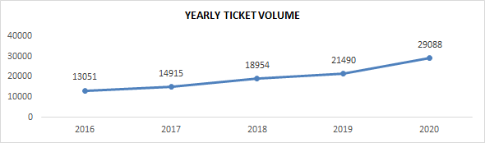
TICKET VOLUME TREND ANALYSIS (2016-2020)
📈 Consistent Growth Trend : Ticket volume shows a steady increase from 2016 to 2020 indicating continuous growth in IT support demand.
👥 Rising Workload Pressure : Increasing ticket numbers indicate growing workload pressure on the IT support team.

Slide 12
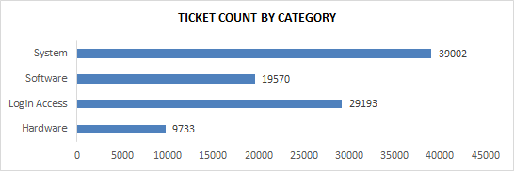
TICKET DISTRIBUTION BY REQUEST CATEGORY
The average daily ticket volume is 53.
System and Login Access categories account for the vast majority of IT requests.
Hardware has the lowest ticket volume but the longest resolution time.
System issues account for 40% of tickets, Login Access 30%, Software 20% and Hardware 10%

Slide 13
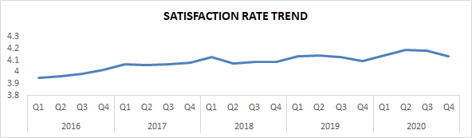
SATISFACTION RATE TREND OVER TIME (2016-2020)
😊 Consistently High Satisfaction Levels : Customer satisfaction remains stable and high (around 4+) throughout the observed period.
🔧 Service Quality Maintained Despite Ticket Growth : Even with increasing ticket volume satisfaction levels have not declined reflecting effective issue resolution.

Slide 14
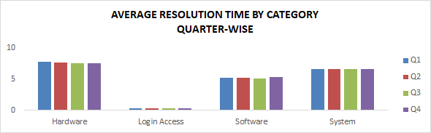
RESOLUTION TIME EFFICIENCY ANALYSIS BY REQUEST CATEGORY
Hardware issues take the longest to resolve 7.63 days.
System issues average 6.62 days.
Software requests average 5.24 days.
Login Access requests are resolved very quickly (0.31 days).
Hardware resolution is a systemic issue affecting all agent age groups.

Slide 15
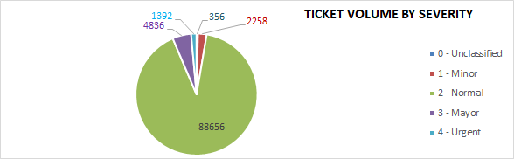
SEVERITY-BASED IT TICKET DISTRIBUTION ANALYSIS
📌 Majority of Tickets Fall Under “Normal” Severity : Most tickets are classified as Severity 2 (Normal) indicating routine operational issues form the bulk of IT support requests.
❓ Minimal Unclassified Tickets : Very few tickets remain unclassified indicating good ticket categorization practices.

Slide 16
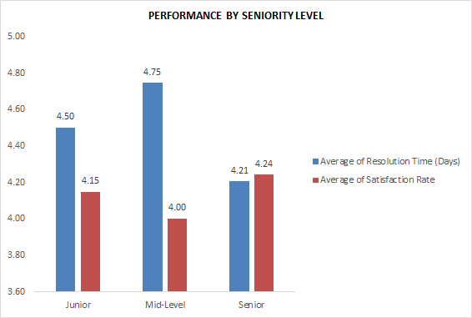
PERFORMANCE BY SENIORITY LEVEL OF AGENTS
Mid-level agents have the highest average resolution time (4.75 days) and a relatively lower satisfaction rate (4.00).
- This indicates that mid career employees (35–44) may have higher expectations which impacts satisfaction levels.

Slide 17
Recommendations
Improve System Stability
Strengthen login & access management
Optimize Agent Allocation
Improve Severity-Based Workflow
Upgrade Ticket Management Tools
Prioritize proactive monitoring and preventive maintenance for system-related issues.
Automate password resets and access-related requests.
Balance ticket distribution across agents using workload based assignment.
Redesign severity based workflows to prevent prolonged resolution of normal severity tickets.
Invest in upgrading the ticket management software with better automation, categorization and tracking features.
Overall Impact: These recommendations focus on reducing recurring issues, improving response efficiency and enhancing customer satisfaction through data driven decision making.

Slide 18
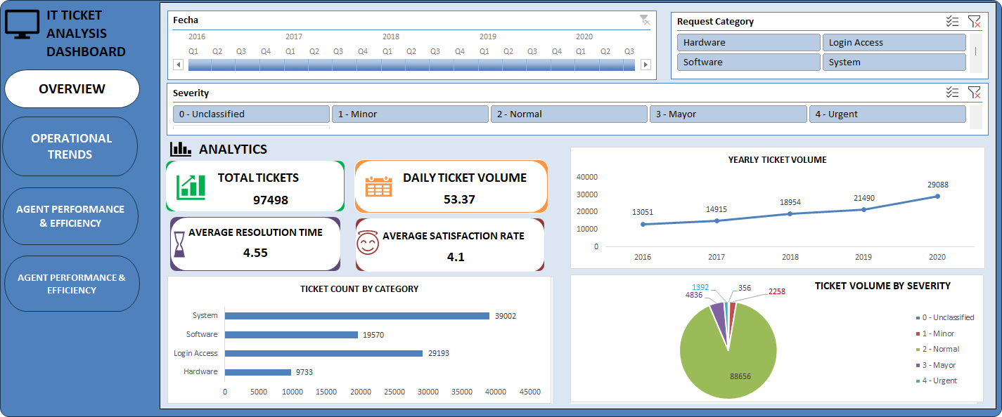
Dashboard

Slide 19
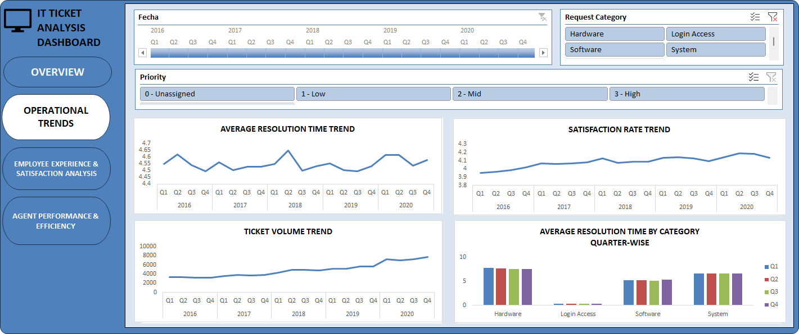
Dashboard

Slide 20
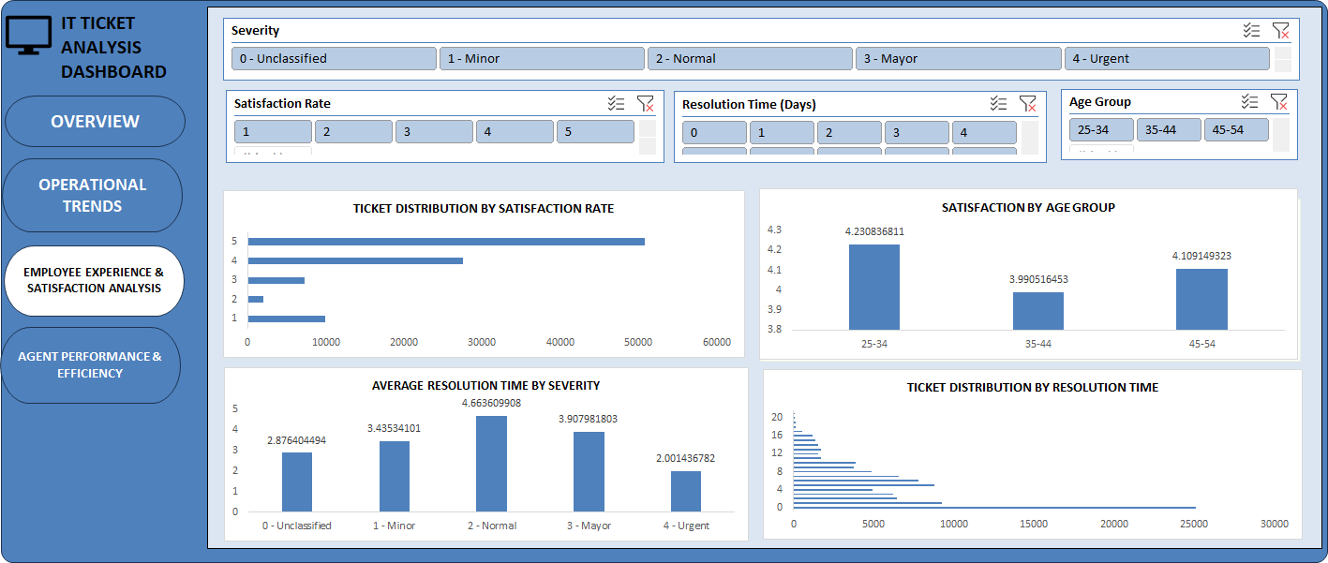
Dashboard

Slide 21
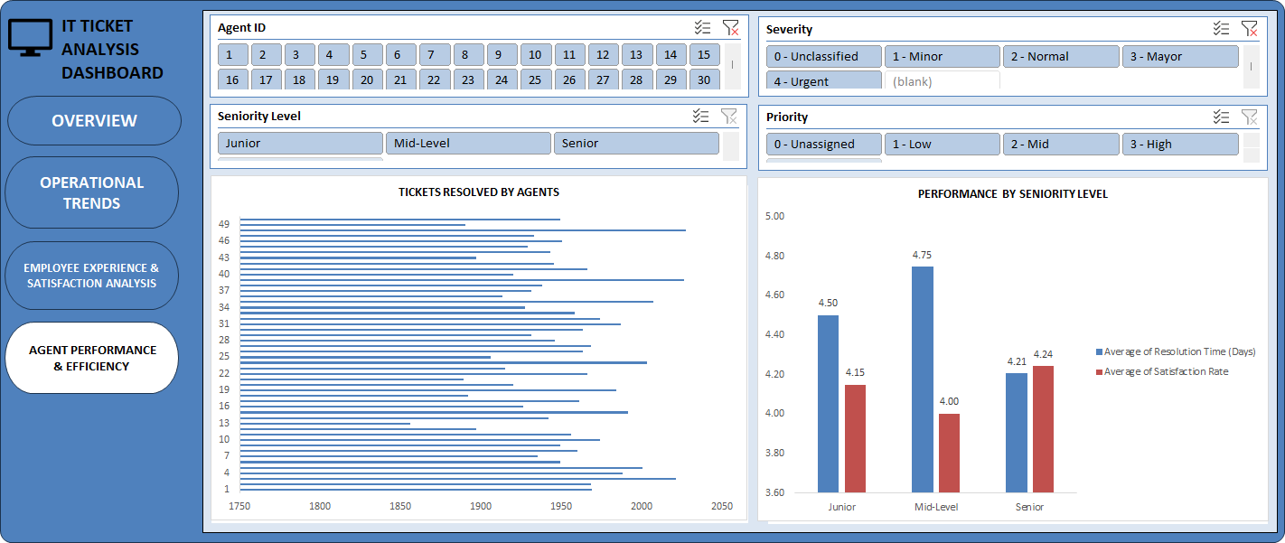
Dashboard

Slide 22


CONCLUSION
The analysis reveals clear patterns in ticket volume, resolution time and satisfaction levels across categories and time periods.
Certain request categories and time periods require higher technical effort leading to longer resolution times.
Agent performance and workload distribution indicate opportunities for process optimization and skill enhancement.
The dashboard provides a centralized, real time view of IT support performance enabling faster and data-driven decisions.
Overall, the insights support strategic investments in technology, training and resource allocation to improve efficiency and user satisfaction.

Slide 23
REFERENCES
Internal IT Support Ticket Dataset (Provided for Academic Project Use)
Google Sheets & Excel Help Resources (Data Cleaning & Visualization Techniques)
Classroom Notes & Project Guidelines Shared by Faculty
Self-Analysis and Interpretation Based on Dataset Insights

Slide 24




Thank you!

